Slide 1

National University of Computer and Emerging Sciences
Artificial Neural Networks
AI-5004 Adv. Topics in Generative AI
Dr. Muhammad Nouman Noor
Department of AI & DS

Slide 2
Goals
Review of Previous Lecture
Today’s Lecture
Overfitting, underfitting generalization, regularization, cross-validation
Artificial Neural Networks

Slide 3
Review of Previous Lecture

Slide 4
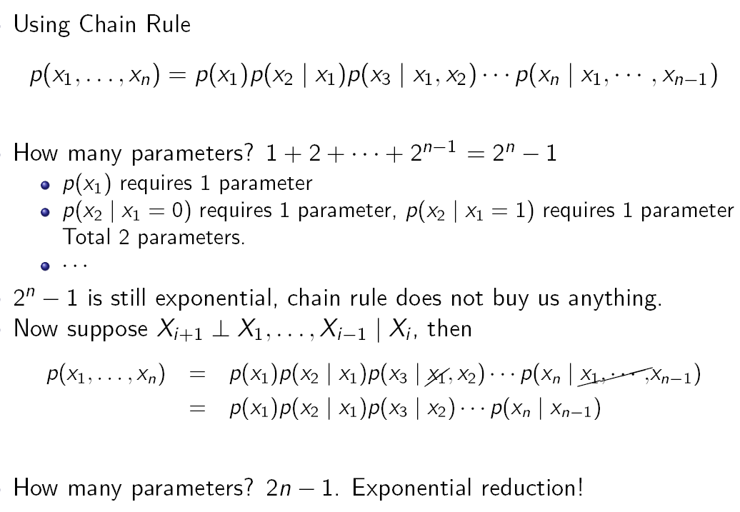
Assumption with conditional independence

Slide 5
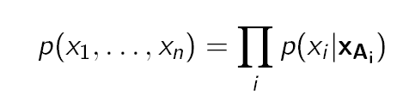
Bayesian Networks: General Idea
Use conditional parameterization (instead of joint parameterization)
For each random variable X_{i} , specify p(x_{i} |x_{Ai} ) for set X_{Ai} of random variables
Then get joint parametrization as
This is a Bayesian Network.
It is a classical approach for data generation
Need to guarantee it is a valid probability distribution.
Choosing those variable is important. How?

Slide 6
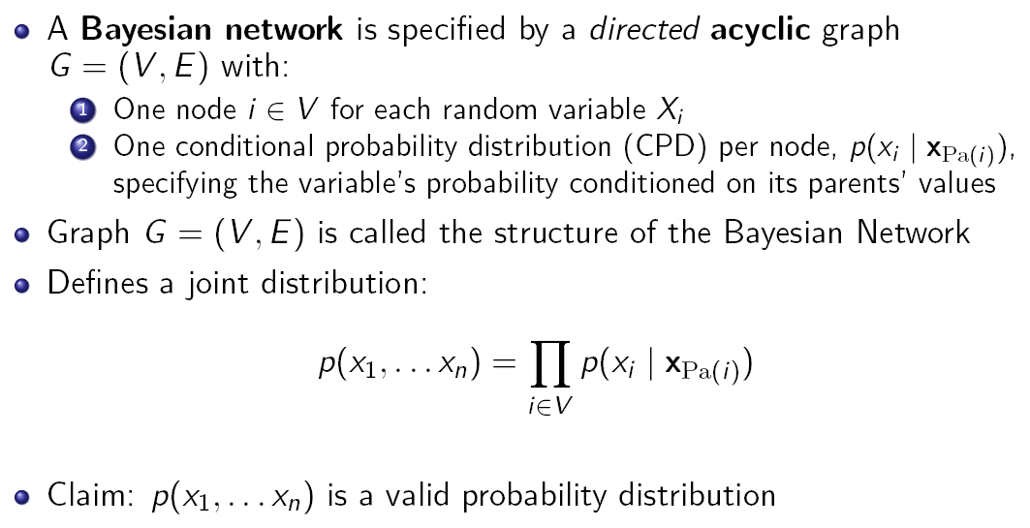
Bayesian Networks: Formal Definition

Slide 7
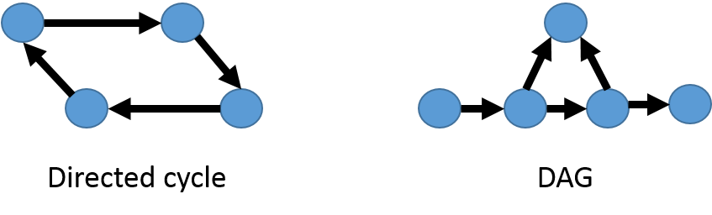
What is a Directed Acyclic Graph?
DAG stands for Directed Acyclic Graph

Slide 8
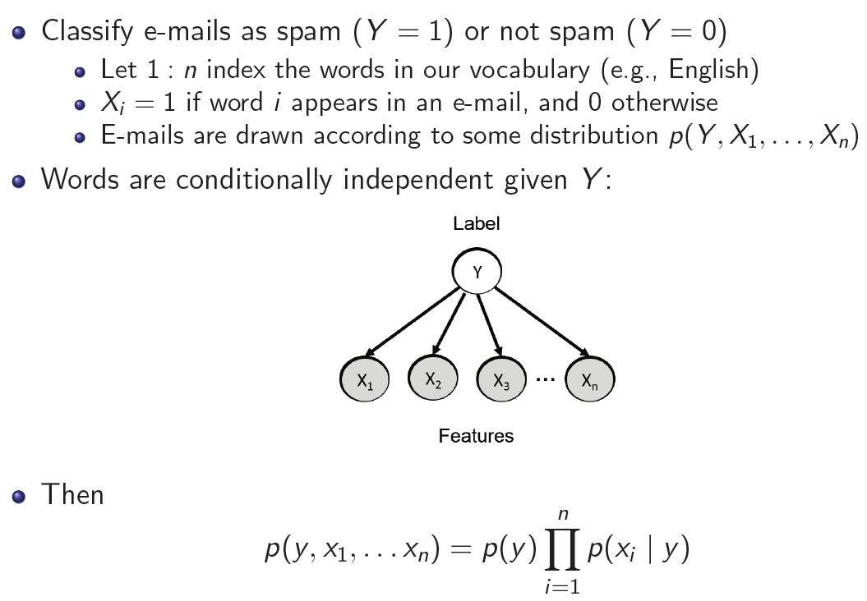
Naive Bayes: A Generative Classification Algorithm

Slide 9
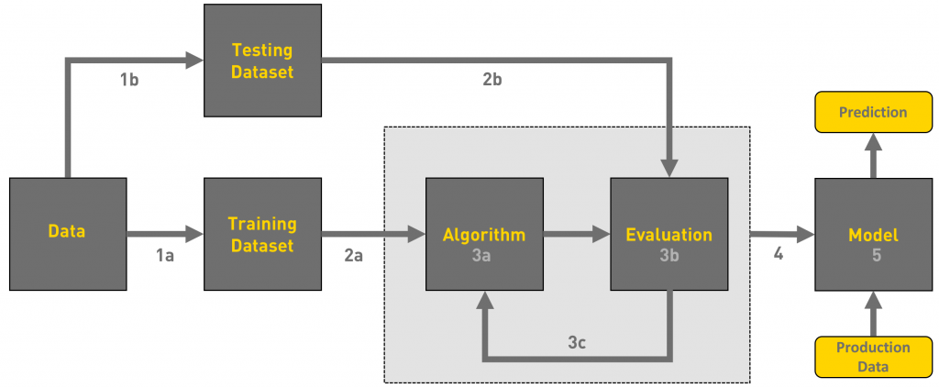
Workflow of ML tasks

Slide 10
Thought Provoking Question
How can we evaluate the performance on the test data set when we can observe only the training set?

Slide 11
Today’s Lecture

Slide 12
Machine Learning
The factors determining how well a machine learning algorithm will perform are its ability to
1. Make the training error small.
2. Make the gap between training and test error small.
These two factors correspond to the two central challenges in machine learning:
underfitting and overfitting.

Slide 13
Machine Learning Models
Underfitting occurs when the model is not able to obtain a sufficiently low error value on the training set.
Have high bias
Have a limited ability to adapt to the training data
This means that the model does not learn enough patterns from the training data, and possibly not even capture the dominant trend.

Slide 14
Machine Learning Models
High Training Error
Cannot understand the data
Low Complexity
Too less parameters, layers of model, neurons etc
Less Generalization Ability
Poor performance on test data
High Bias
Cannot adopt to new data

Slide 15
Machine Learning Models
Causes of underfitting
Model Complexity: Model is too basic or has too few parameters, it might struggle to capture the patterns in the data.
Insufficient Training: Small training dataset or not representative of the true data distribution, the model might fail to generalize.
Feature Selection: If important features are not included or if feature engineering is inadequate.
Over-regularization: Applying excessive regularization techniques by discouraging the model from fitting the training data closely.

Slide 16
Machine Learning Models
Dealing with underfitting:
Increase Model Complexity: More parameters, layers, or more complex architectures.
Feature Engineering: Enhance feature selection.
Reduce Regularization: Reduce its strength or consider removing it altogether.
Collect More Data: More diverse and representative training data.
Model Selection: Choose a more suitable algorithm that aligns with the complexity and characteristics of the data.

Slide 17
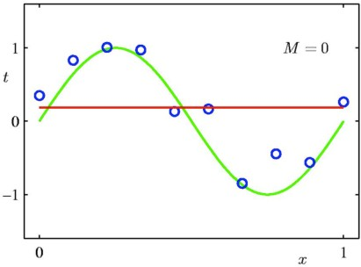
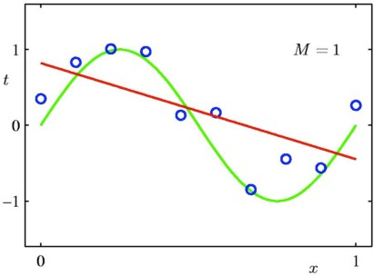
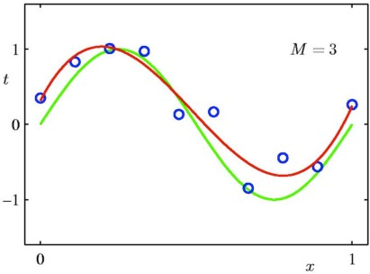
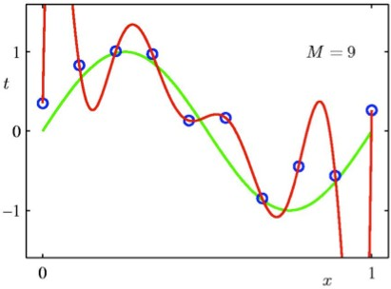
Some Fits to the Data
For M=9, we have fitted the training data perfectly.

Slide 18
Machine Learning Models
Overfitting occurs when the gap between the training error and test error is too large.
Model performs extremely well on the training data but fails to generalize to new, unseen data (High test error)
The most common problem in applied machine learning is overfitting.
It mean we have high variance

Slide 19
Machine Learning Models
High Training Accuracy
Model is memorizing the training examples too well.
High Validation/Test Error
Poor performance on new or unseen data (validation or test data).
High Variance
High variance and doesn't generalize well.
Complex Model
Large number of parameters, complex architecture, etc.

Slide 20
Causes of overfitting
Model Complexity
If the model is too complex, it can capture noise in the data, leading to overfitting.
Small Training Dataset
With a limited amount of training data (memorize the examples).
Feature Overfitting
Including too many features or features that are not relevant to the target can lead to overfitting.
Insufficient Regularization
Lack of proper regularization techniques
Data Noise
The model might learn to fit that noise.

Slide 21
Dealing with overfitting
Simplify the Model
Reduce the model's complexity by decreasing the number of parameters, layers, or features.
Regularization
Apply techniques like L1 or L2 regularization to penalize large parameter values and prevent overfitting.
Cross-Validation
Use techniques like k-fold cross-validation to evaluate the model's performance on different subsets of the data.
Feature Selection
Choose relevant features, avoid incorporating noise.
Increase Data
Gather more diverse and representative training data
Early Stopping
Stop training when performance starts to degrade.

Slide 22
Machine Learning Models
Both overfitting and underfitting can lead to poor model performance.
Finding the right balance between model complexity and the amount of available data is crucial to avoid overfitting.
The goal is to build a model that can generalize well to new data while still capturing meaningful patterns in the training data.

Slide 23
Some Fits to the Data
For M=9, we have fitted the training data perfectly.

Slide 24
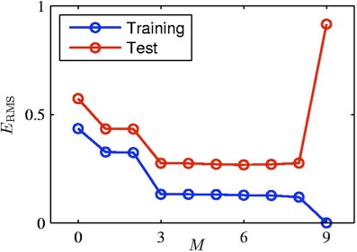
Overfitting
Consider a separate test set containing 100 new data points generated using the same procedure that was used to generate the training data.
For M=9, the training error is zero ! The polynomial contains 10 degrees of freedom corresponding to 10 parameters w, and so can be fitted exactly to the 10 data points.
However, the test error has become very large. Why?

Slide 25
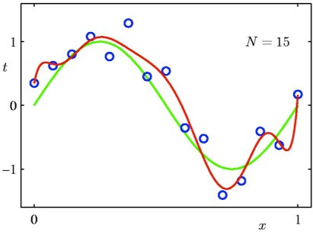
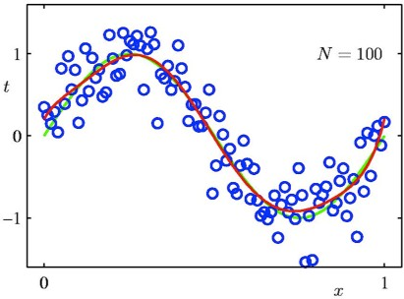
Varying the Size of the Data
9th order polynomial
Increase the Training Data
For a given model complexity, the overfitting problem becomes less severe as the size of the dataset increases.

Slide 26
Generalization
The central challenge in machine learning is that our algorithm must perform well on new, previously unseen inputs
Not just those on which our model was trained.
The ability to perform well on previously unobserved inputs is called generalization.
Minimum training error is desirable
Minimum test error is the requirement

Slide 27
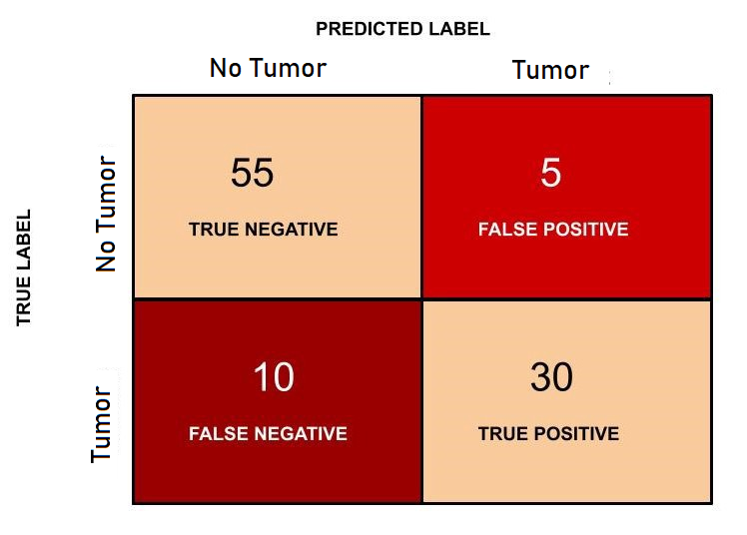
Performance Evaluation of a machine learning model

Slide 28
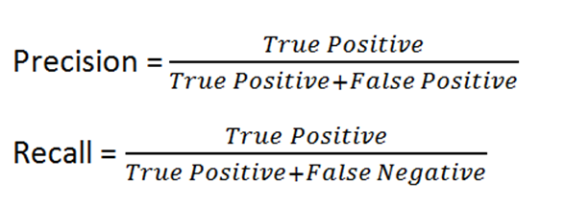
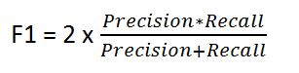
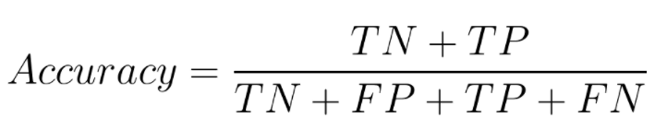
Performance Evaluation of a machine learning model

Slide 29
Performance Evaluation of a machine learning model
A true positive (TP) is an outcome where the model correctly predicts the positive class.
True negative (TN) is an outcome where the model correctly predicts the negative class.
A False positive is an outcome where the model incorrectly predicts the positive class.
False negative is an outcome where the model incorrectly predicts the negative class.

Slide 30
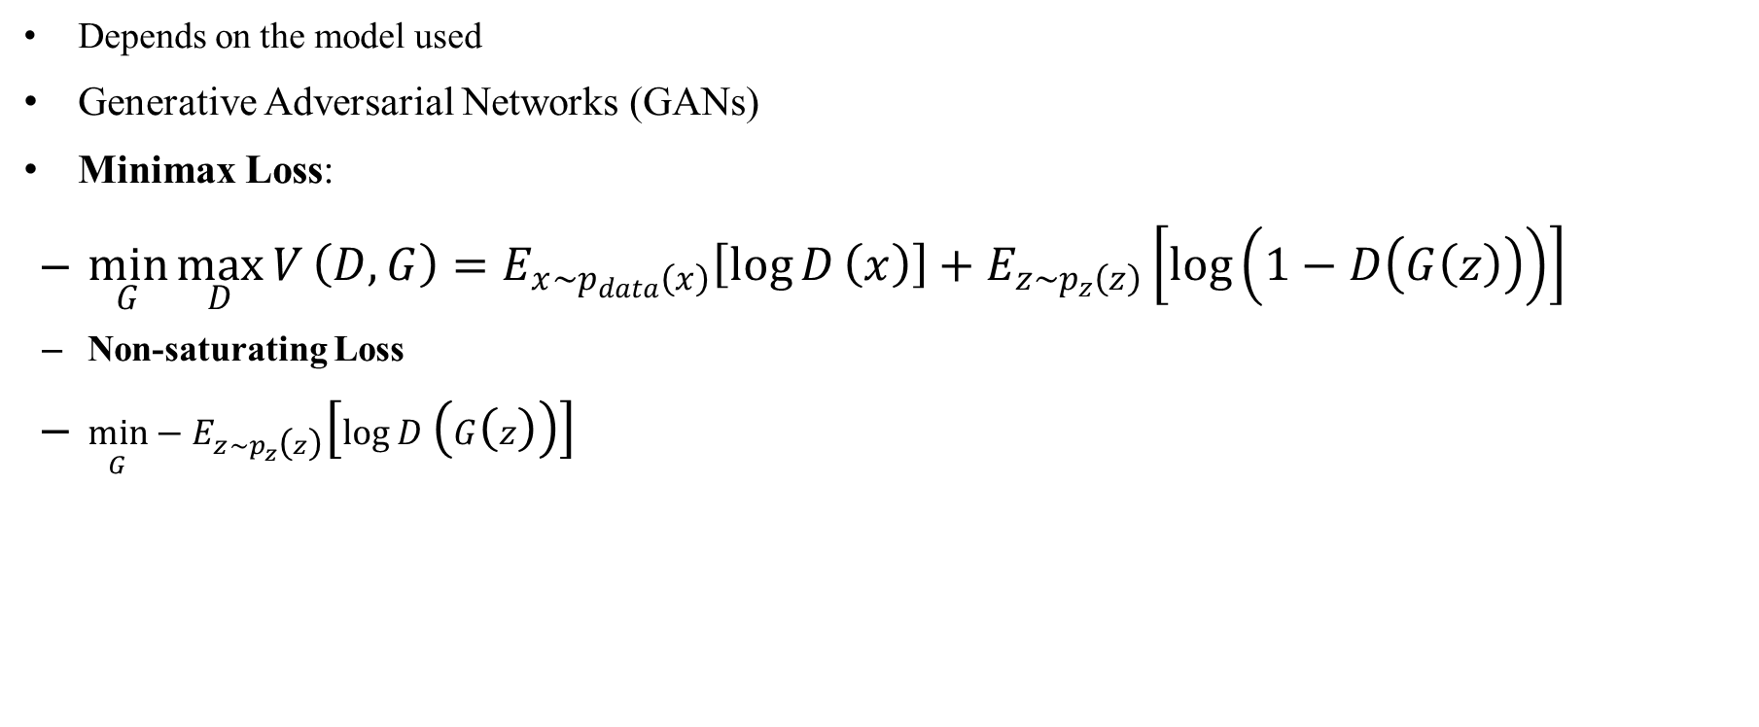
Generative Models: Evaluation

Slide 31
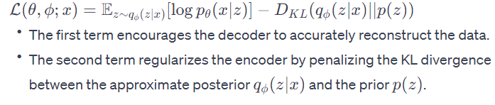
Generative Models: Evaluation
Variational Autoencoders (VAEs)
Evidence Lower Bound

Slide 32
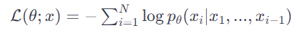
Generative Models: Evaluation
Autoregressive Models
Negative Log-Likelihood
Energy-Based Models
Contrastive Divergence / Maximum Likelihood
Normalizing Flows
Negative Log-Likelihood

Slide 33
Artificial Neural Networks

Slide 34
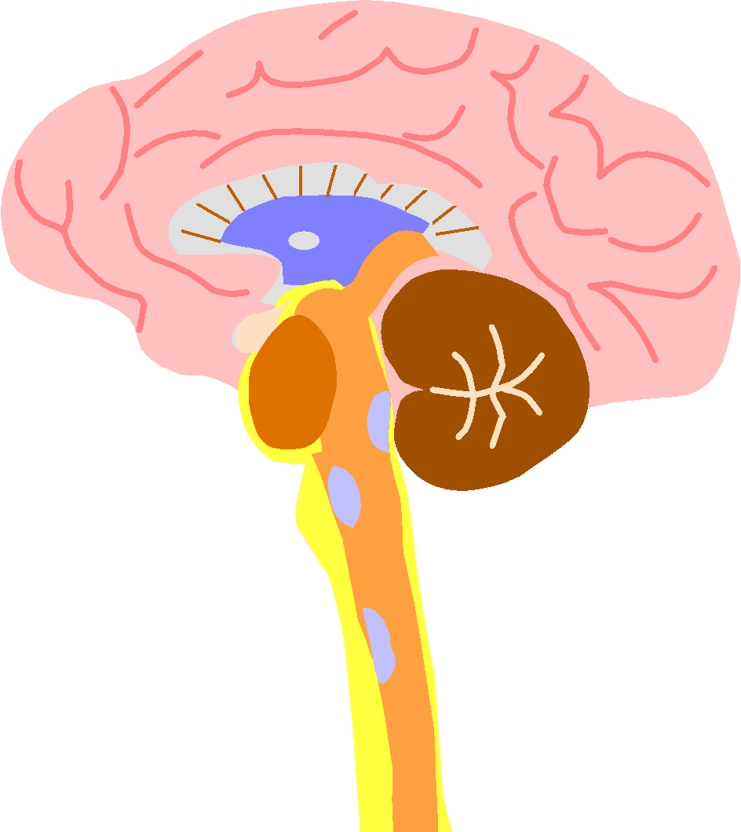
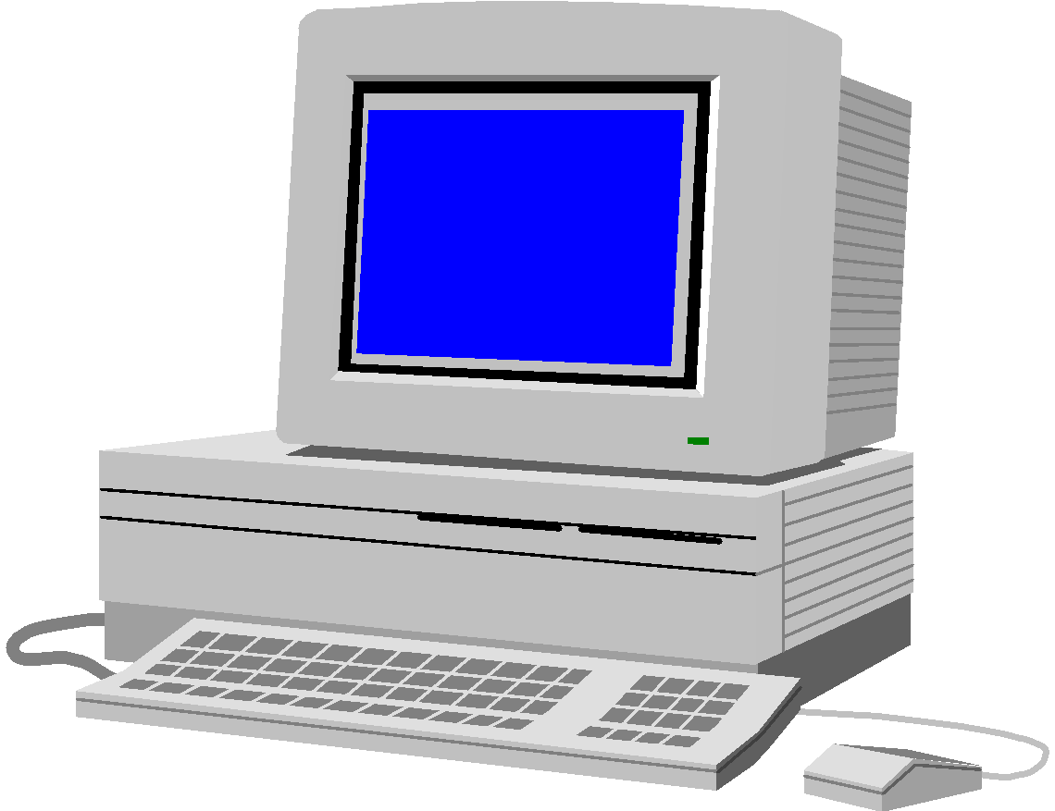
Brain and Machine
The Brain
Pattern Recognition
Association
Complexity
Noise Tolerance
The Machine
Calculation
Precision
Logic

Slide 35

The biological inspiration
The brain has been extensively studied by scientists.
Vast complexity prevents all but rudimentary understanding.
Even the behaviour of an individual neuron is extremely complex

Slide 36
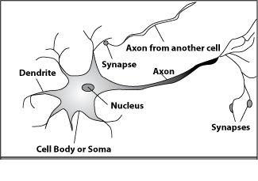
How do our brains work?
A processing element
Dendrites: Input
Cell body: Processor
Synaptic: Link
Axon: Output

Slide 37
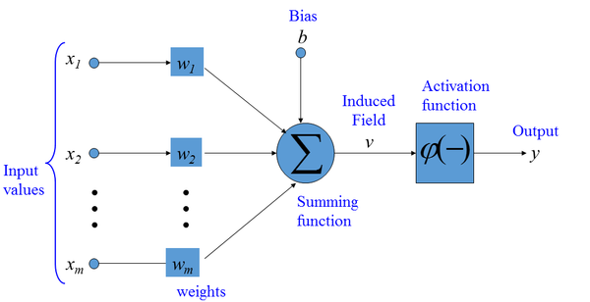
An Artificial Neuron
Each neuron has weighted input connections from each of the units in the preceding layer.
The unit performs a weighted sum of its inputs, to give its activation level.
Activation level is passed through a sigmoid activation function to determine output.

Slide 38
Artificial Neural Networks
The “building blocks” of neural networks are the neurons.
In technical systems, we also refer to them as units or nodes.
Basically, each neuron
receives input from many other neurons.
changes its internal state (activation) based on the current input.
sends one output signal to many other neurons, possibly including its input neurons (recurrent network).

Slide 39
Artificial Neural Network
Need a complex model to understand complex patterns, such as object detection, face recognition, etc.
Most commonly used architecture is known as the multilayer perceptron.
Basic features of MLP
A nonlinear activation function
One or more hidden layers
High degree of connectivity (fully connected)

Slide 40
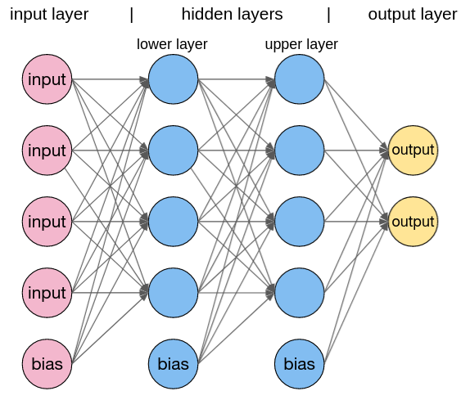
Artificial Neural Network

Slide 41
Artificial Neural Network
A popular method for the training of multilayer perceptron is the back-propagation algorithm (Generalized Delta Rule)
Forward phase:
The input data is propagated through the network, layer by layer, until it reaches the output.
Backward phase:
An error is calculated by comparing the output of the network with a desired response.
This error is propagated through the network in backward direction.

Slide 42
Neural Network
Network architecture or topology plays an important role for neural net classification.
Optimal topology for the problem at hand.
Hyperparameters:
Number of Layers,- Number of Neurons in Each Layer, Learning Rate, Activation Functions, Batch Size, Number of Epochs, Optimizer, Loss Function, Regularization Techniques, Initialization Methods, Learning Rate Decay, Momentum, Early Stopping, Gradient Clipping.

Slide 43
Neural Network
Hidden Neurons
The hidden neurons act as feature detectors
The hidden neurons gradually “discover” the main features to understand the training data.
They perform nonlinear transformations on the input
Feature space.
Classes may be more easily separated from each other

Slide 44
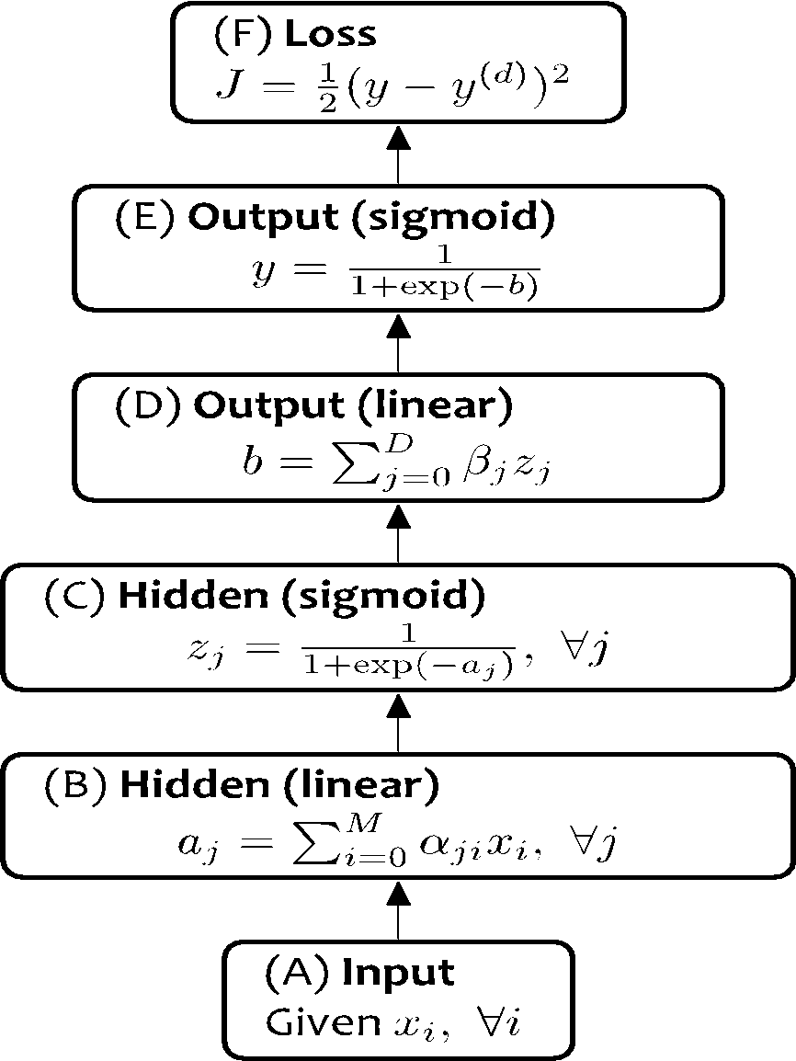
Neural Network
Output
y
Hidden Layer
z₁
z₂
…
z_{D}
Input
x₁
x₂
x₃
…
x_{M}

Slide 45
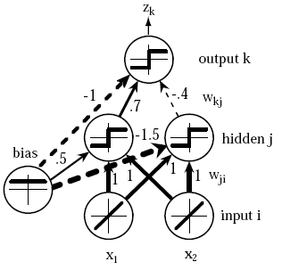
Neural Network

Slide 46
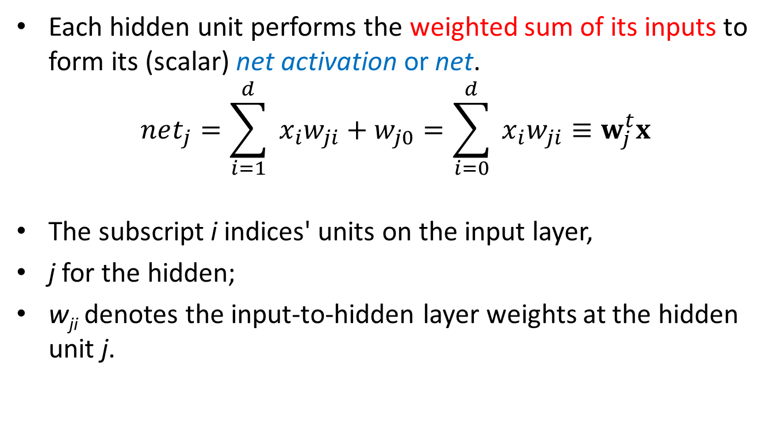
Neural Network

Slide 47
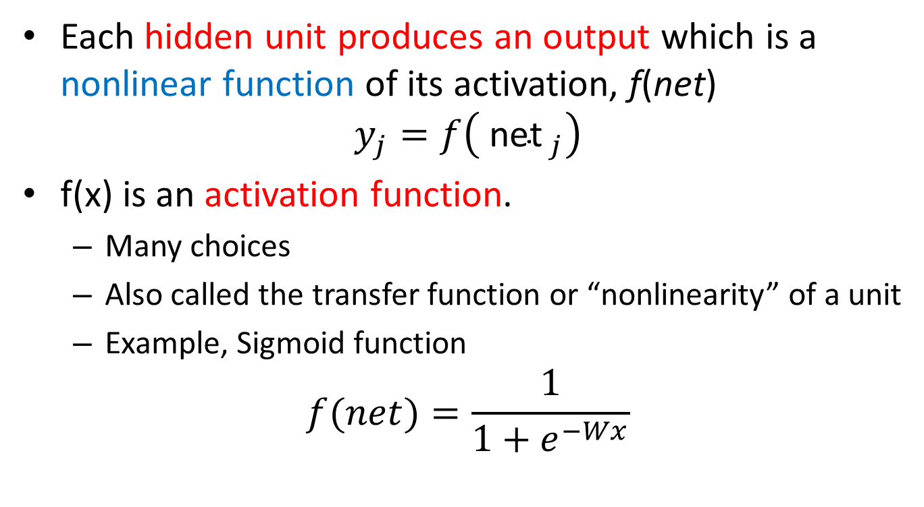
Neural Network

Slide 48
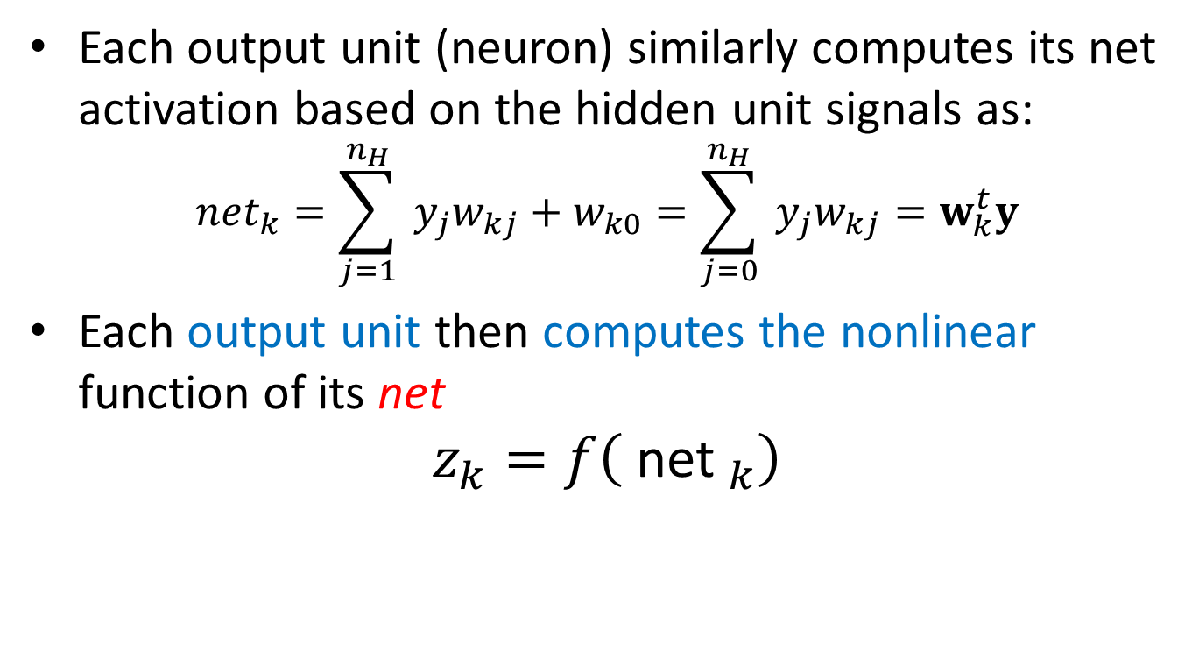
Neural Network

Slide 49
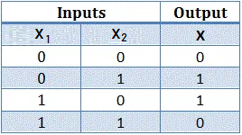
Neural Network

Slide 50
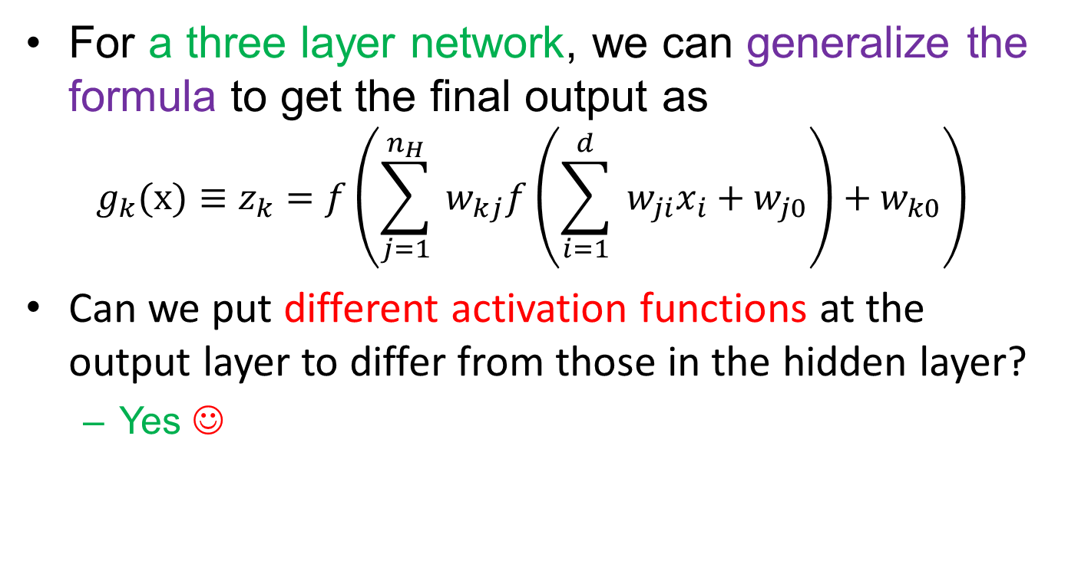
Neural Network

Slide 51
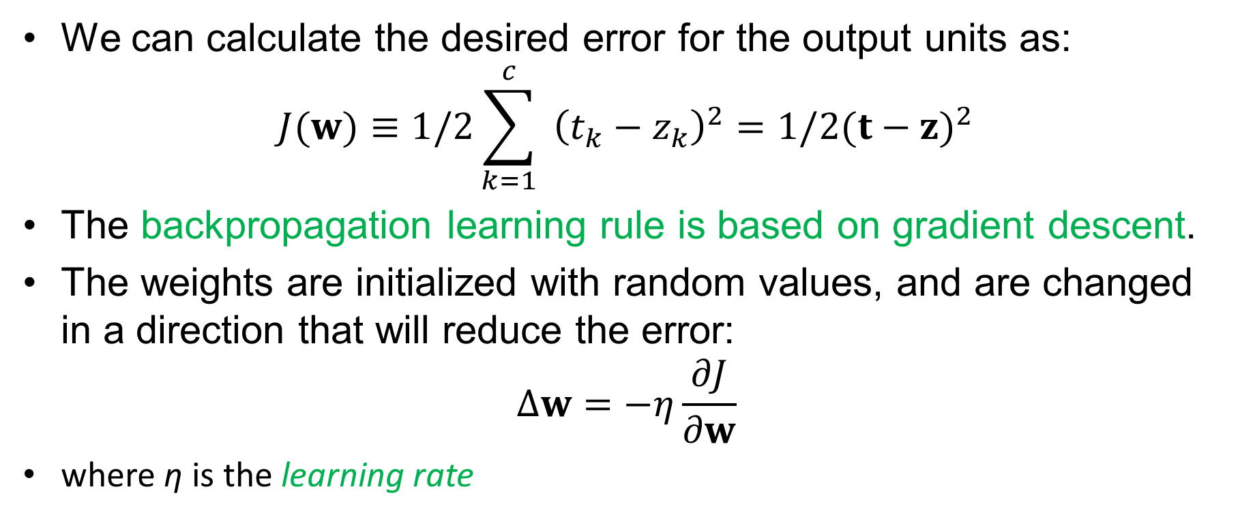
Backpropagation algorithm

Slide 52
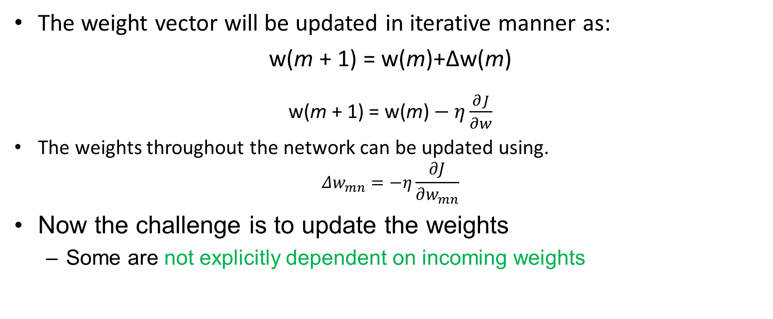
Backpropagation algorithm

Slide 53
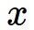
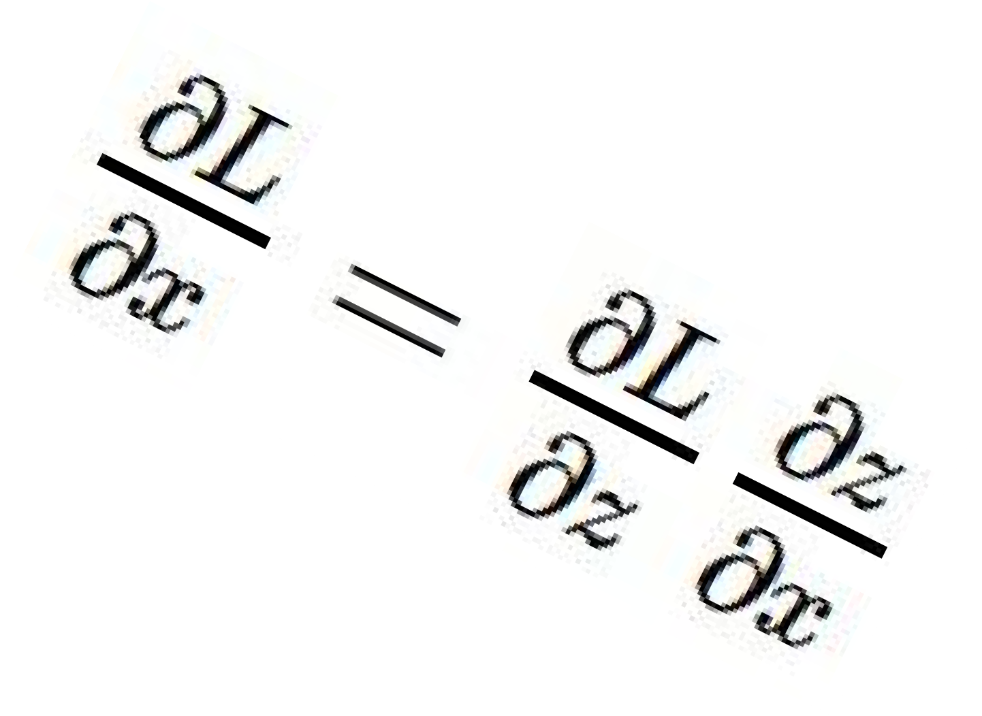
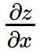
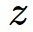
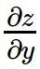
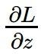
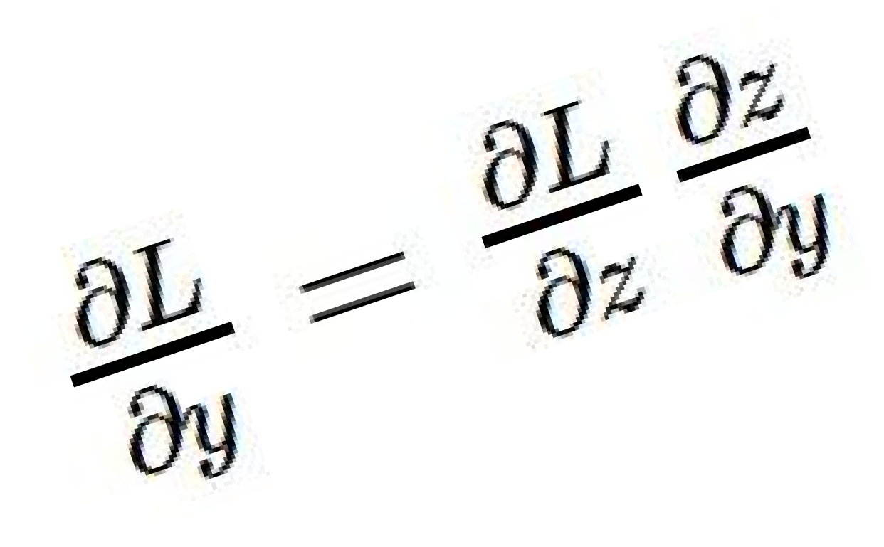
activations
“local gradient”
f
gradients

Slide 54
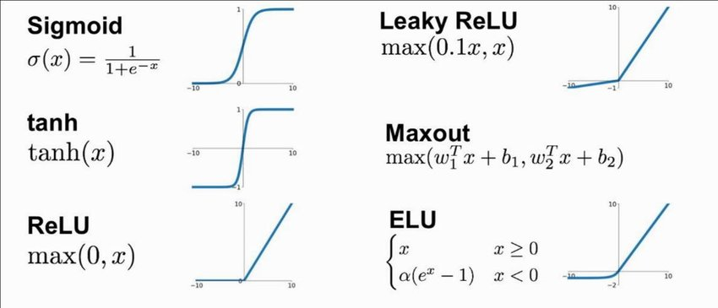
Activation Functions
Backpropagation can work with any activation function
The activation function should meet the criteria of
Differentiabity, continuity, nonlinear.
The sigmoid function possesses the desirable properties of the activation function

Slide 55
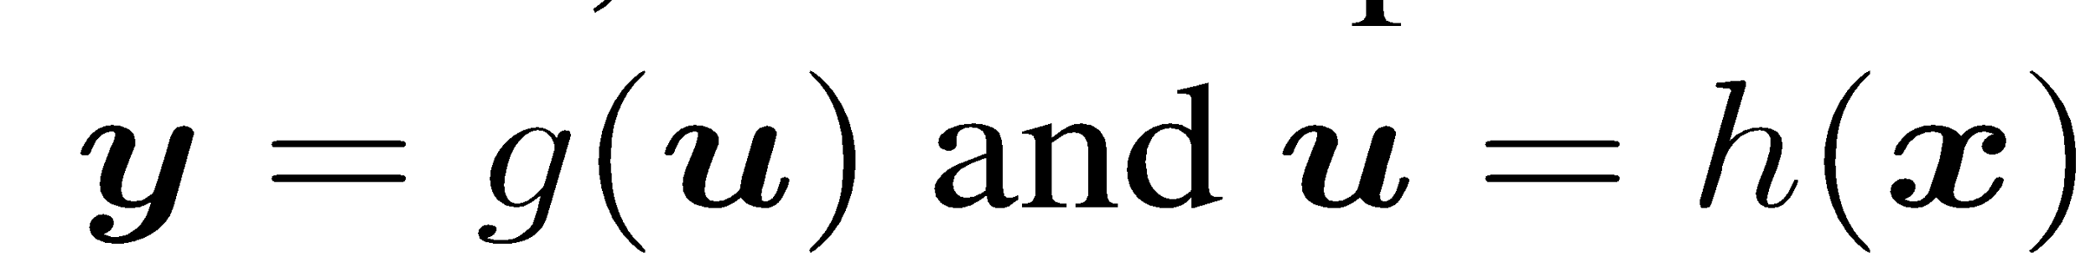
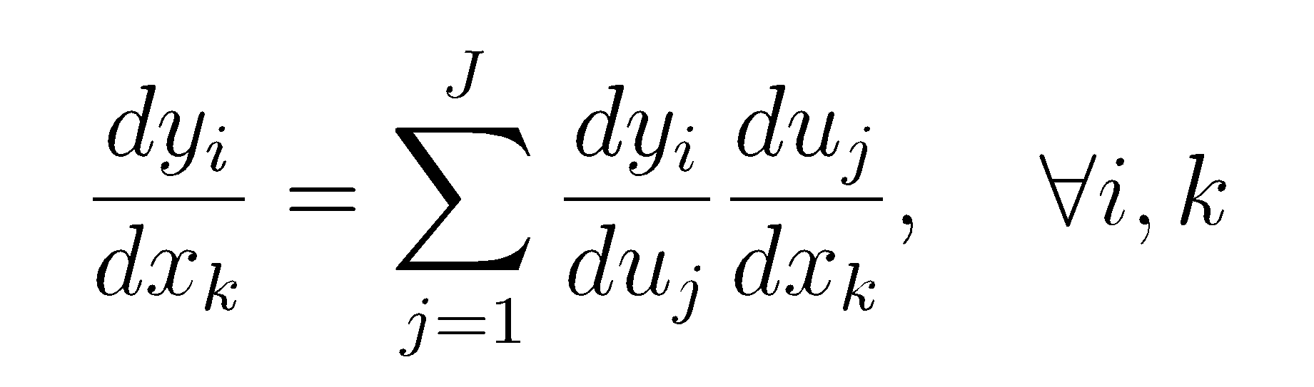
Chain Rule
Given:
Chain Rule:
y₁
u₁
u₂
…
u_{J}
x₂

Slide 56
Chain Rule
Given:
Chain Rule:
y₁
Backpropagation is just repeated application of the chain rule from Calculus.
u₁
u₂
…
u_{J}
x₂

Slide 57
Neural Network
y
Output
a₁
a₂
…
a_{D}
Hidden Layer
x₁
x₂
x₃
…
x_{M}
Input
Notes:
TODO: Include the math on the right.
TODO: Show the parameters.

Slide 58
Building a Neural Net
y
Output
a₁
a₂
…
a_{D}
Hidden Layer
D = M
1
1
1
x₁
x₂
…
x_{M}
Input
Notes:
What if we connect all the X to all the Z?

Slide 59
Building a Neural Net
y
Output
a₁
a₂
…
a_{D}
Hidden Layer
D = M
x₁
x₂
…
x_{M}
Input
Notes:
What if we connect all the X to all the Z?

Slide 60
Building a Neural Net
y
Output
a₁
a₂
…
a_{D}
Hidden Layer
D = M
x₁
x₂
…
x_{M}
Input
Notes:
What if we connect all the X to all the Z?

Slide 61
Building a Neural Net
y
Output
a₁
a₂
…
a_{D}
Hidden Layer
D < M
x₁
x₂
x₃
…
x_{M}
Input
Notes:
What if we connect all the X to all the Z?

Slide 62
Building a Neural Net
y
Output
x₁
x₂
…
x_{M}
Features
Notes:
This is regular perceptron

Slide 63
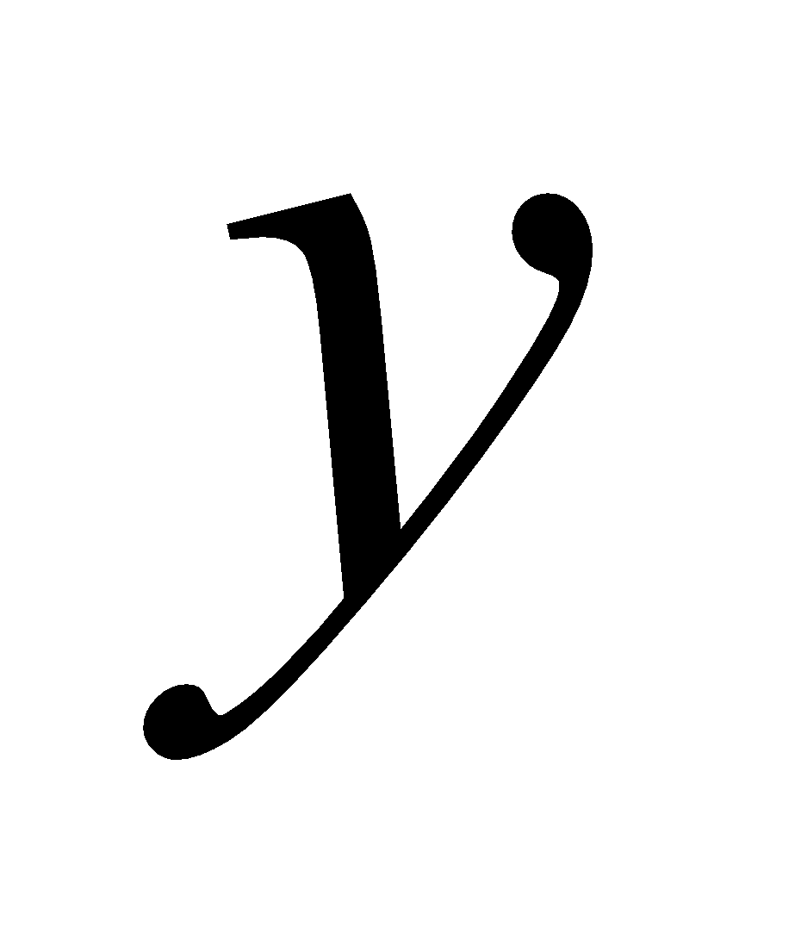
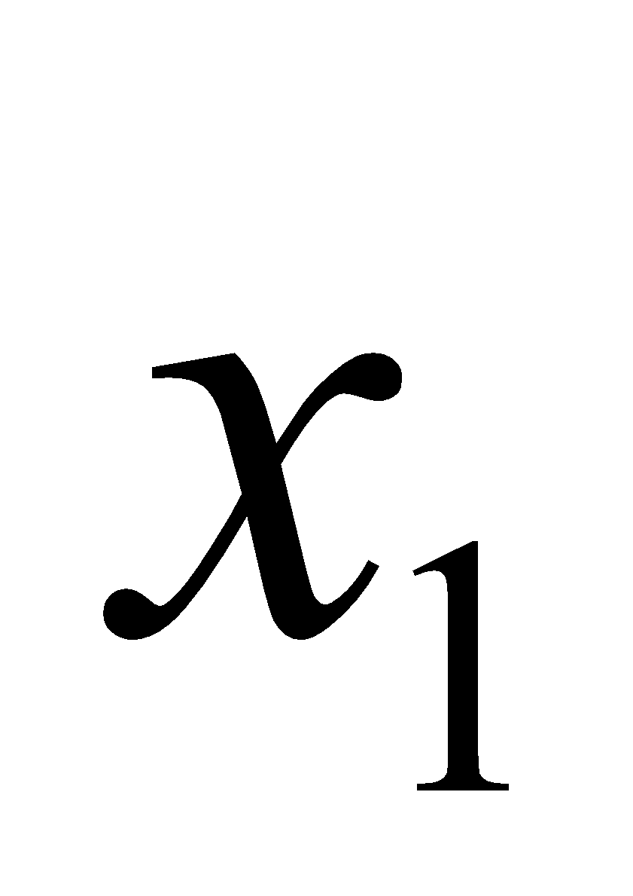
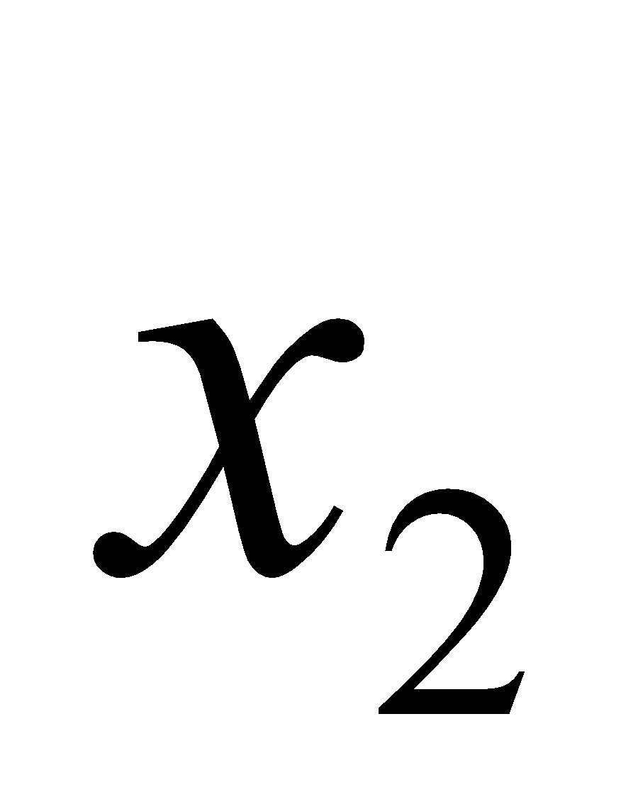
Decision Boundary
0 hidden layers: linear classifier
Hyperplanes

Slide 64
Decision Boundary
1 hidden layer
Boundary of convex region (open or closed)
Notes:
We saw with XOR

Slide 65
Decision Boundary
2 hidden layers
Combinations of convex regions

Slide 66
Reading Tasks
Back Propagation Algorithm

Slide 67
References
Chapter 5, Deep learning book by MIT
Chapter 4, Neural Networks and Learning Machines, Haykin
Chapter 5, Pattern Recognition and Machine Learning, Bishop

Slide 68
Thank You ☺

